Slide 1
Spices
The Export route

Slide 2
Spice Export: Profitable Business
At present India, is exporting more than 75 varieties of spices across the globe
Top 10 exported spices in terms of value are chilli, cumin, cardamom seeds, turmeric, asafoetida, garlic, cassia, pepper and curry leaves
Potential importers of Indian spices include China, the USA, Vietnam, Thailand, Hong Kong, UK, Sri Lanka and Malaysia

Slide 3
Spices: Trade Information & Statistics

Slide 4
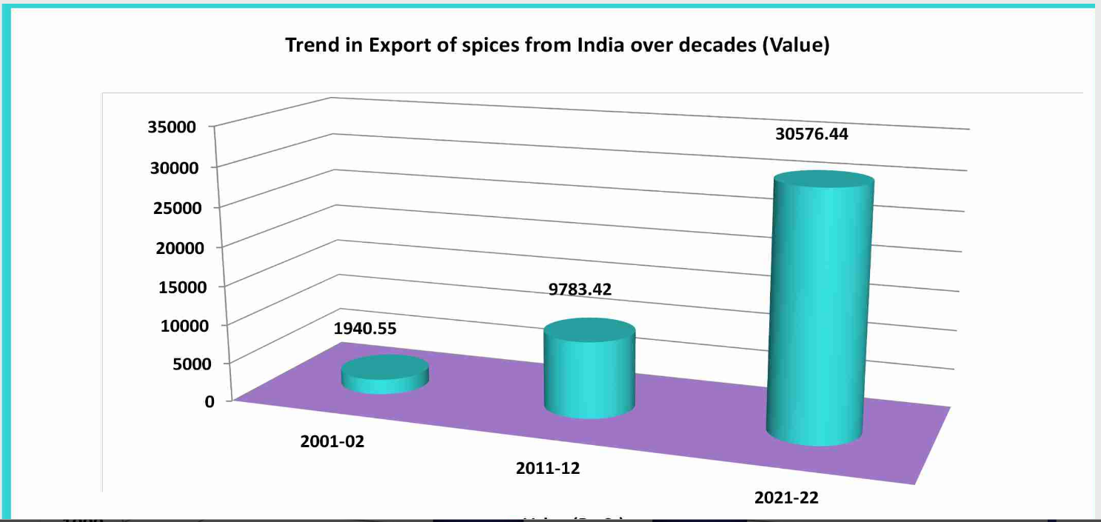
Spices: Trade Information & Statistics

Slide 5
Spices: Trade Information & Statistics

Slide 6
Spice Export: The Prerequisites
First, choose how you want to venture into this business. You can enter into export of spices as:
Wholesaler
Retailer
Supplier
Manufacturer
All the above type of businesses would need to get registered under the apt Act and bylaws
Outline an efficient supply chain for the business

Slide 7
Spice Export: The Prerequisites
Manufacturer cum exporter needs to arrange the following machinery used in the processing and packaging of spices:

Slide 8
Spice Export: The Certifications
Basic certifications required for Spice Export are:
Incorporation Certificate
Certificate of Registration as Exporter from the Spice Board
Import Export Code from DGFT
Food Safety Licence and Registration from FSSAI
GST Registration
Phytosanitary Certificate

Slide 9
Spice Export: The IEC Code
Import Export Code (IEC): A 10-digit code necessary for Indian export-import business:
Issued by DGFT, Ministry of Commerce
Importers need IEC to clear customs
Exporters need it to send shipment and receive payments
IEC code does not require filing returns or renewal
IEC certificate is valid for a lifetime

Slide 10
Spice Export: The IEC Code
Import Export Code (IEC): The Prerequisites
A valid PAN issued by Income Tax Department of India is mandatory
Bank account in the name of the firm or individual, as IEC certificate is issued in the name of applicant
Business entity should be registered under the Registrar of Companies
Applicant needs to submit documents such as identity proof, address proof and detail of business entity to the DGFT office

Slide 11
Spice Export: The IEC Code
How to apply IEC Code?
To know the process of application step by step click on the link below:
APEDA_Agri_Export_Manual_FINAL.pdf

Slide 12
Spice Export: RCMC
Registration-Cum-Membership Certificate: The Online Registration Process
Sign-up through the APEDA Website. (Click on "Register as Member" link on the Home Page)”
The exporter require to first enter the basic detail, IE CODE, Email ID & Mobile number and submit.
An OTP (One Time Password) for confirming the details will be sent on E-mail and Mobile number. Exporter should enter the OTP of mobile and E-mail on the verification screen to verify the both and click on Submit to proceed for application.
After verification confirmation, exporter will require to fill online application and upload the required documents. The documents should be in the JPEG, PDF or PNG formats only. The exporter should enter all required information carefully and ensure correct information is submitted in the online application form.

Slide 13
Spice Export: RCMC
On-line application can be completed in one or more sessions by revisiting the website using the assigned OTP (One Time Password) of E-mail and Mobile. After filling the fields, the exporter can save the information in between by using the Save button. The exporter can edit the filled data until online payment is not made.
The exporter may submit registration fees of Rs. 5000/- excluding taxes = Rs. 5900/- (with GST) may be made through any of the following modes:- Online • Credit Card(MasterCard and Visa) Debit Card (MasterCard and Visa) Offline • Demand draft in favor of “APEDA” payable at respective cities of APEDA offices (Note :- APEDA GST No. – 07AAAJA1150H1ZU)

Slide 14
Spice Export: RCMC
After completion of Payment process an application number will be generated. Please note the application number for future reference.
On issuance of RCMC, Login detail is sent to the registered email of the exporter. The Exporter may login in to their account through “Exporter Login” link given at APEDA website.
The exporter can view the status of the RCMC application by clicking the "Track Application" link to view the status of application by submitting the IE Code and Application number until it is issued

Slide 15
Spice Export: RCMC
Following documents are required with application form:
1. Self-certified copy of Import-Export code issued by D.G.F.T.
2. Bank Certificate duly signed by the authorities.
3. In case the exporter desired to register as Manufacturer Exporter, they should furnish a self attested copy of the registration of the company with the relevant certification agencies for the products given
After the approval of RCMC from APEDA officials, exporter may take printout of their Certificate through their APEDA Login under the heading of “View RCMC Certificate” under RCMC Menu

Slide 16
Spice Export: FSSAI
The spice manufacturers are required to obtain FSSAI license for spices to produce the spices for the commercial purpose
In the case of export, the manufacturers also require to avail of the FSSAI Central License
Standards of 30 spices and condiments including Cassia, Cumin, Cardamom, Cloves, chilies, cinnamon are mentioned in the Food Safety and Standards Regulation’ 2011
According to the FSSAI regulations, the sale of powered spices & condiments in loose form is strictly forbidden

Slide 17
Spice Export: Types of FSSAI for Spices
There are three type of FSSAI license for spices available to the FBOs in India, which are as follow:
Basic FSSAI Registration: FSSAI Food safety Registration is a must-have requirement for anyone who is willing to establish a food business. The FSSAI license not only regulates the manufacturing of the edible item but also supervises processing and distribution of the same to ensure the safety of the individual who will ultimately be going to consume it.
State FSSAI License Registration: Businesses having yearly revenue between Rs 12 lakhs to 20 crores can opt for the FSSAI state license.
Food business operators (FBOs), transporters, distributors, storage units, are however required to avail of the FSSAI State License Registration

Slide 18
Spice Export: Types of FSSAI for Spices
Central FSSAI License Registration
Business entities whose yearly revenue is well-above Rs 20 crore can apply for FSSAI central license. Eligible FBOs, manufacture, railways, operators in central government, seaport, airport, etc are liable to acquire Central FSSAI license from the FSSAI.

Slide 19
Spice Export: Documents for FSSAI
Form B (Self Attest via Signature)
Floor plan of the premises where the processing of spices takes place.
List of the core member of the company such as Directors/ Partners/ Proprietor along with their contact details, address, and photographs.
List of the installed machinery with complete details such as their brand name, dimension, production capacity, and specification.
List of species to be processed.
Authority letter from the owner of the manufacturing facility.
Water analysis report (Latest one)

Slide 20
Spice Export: Common Documents for FSSAI
8. Proof of Ownership of premises
9. Affidavit of proprietorship/partnership
10. NOC from owner of the premises
11. Food Safety Management Plan
12. Form IX- Nomination of person by the company
13. NOC from Municipal Corporation
14. Document regarding proof of transportation and turnover
15. Declaration form

Slide 21
Spice Export: Phytosanitary Certificate
The Phytosanitary Certificate (PSC) is an official document required for exporting/re-exporting plants, plant products, or other regulated articles.
PSC is issued to indicate that the consignments meet specified Phytosanitary import requirements of importing countries.
The Ministry of Agriculture and Farmer Welfare, Government of India, gives PSC following the guidelines of the International Plant Protection Convention (IPPC).

Slide 22
Spice Export: Phytosanitary Certificate Purpose
The purpose of the Phytosanitary certificate for export is explained in detail below:
A phytosanitary certificate is issued to attest that the plant, plant product, or other regulated articles meet the importing country’s phytosanitary requirements.
The phytosanitary certificate may also support re-export certification to other countries.

Slide 23
Spice Export: Phytosanitary Certificate Products Covered
The exporter needs to obtain the Phytosanitary Certificate for exporting the following types of products:
A phytosanitary Certificate is an important document to export regulated articles such as plants, bulks, and tubers
For importing seeds for propagation, fruits and vegetables, cut flowers and branches, grain, and growing medium.
The phytosanitary certificate is also needed for certain plant products that have been processed and have a potential for introducing regulated pests (For example, cotton or wood).
PSC is needed to export contaminated articles such as empty shipping containers, vehicles, or other organisms.

Slide 24
Spice Export: Phytosanitary Certificate Types & Purpose
This certificate is classified into two types, as mentioned below:
Phytosanitary certificate for export purposes
Phytosanitary certificate for re-export purposes
Phytosanitary certificate for export purposes
The NPPO of the country of origin issues a Phytosanitary certificate for export. A Phytosanitary certificate for export declares that the consignment meets the country’s Phytosanitary requirements. PSC for export is also provided in certain re-export situations for regulated articles in a country other than the country of re-export if compliance with the Phytosanitary import.

Slide 25
Spice Export: Phytosanitary Certificate Types & Purpose
Phytosanitary certificate for re-export purposes
A Phytosanitary Certificate for re-export will be issued by the NPPO of the re-exporting countries where the commodity was not grown or processed to change its nature in that country and only where an original phytosanitary certificate for export is available.

Slide 26
Spice Export: Phytosanitary Certificate
Prescribed Authority
The prescribed authority for issuing the Phytosanitary Certificate for Export is the Plant Quarantine Information System, Department of Agriculture, Co-operation and Farmer Welfare, Government of India.
Validity Details
To ensure the Phytosanitary integrity and physical integrity of consignment, the validity of PSC before export is limited to a maximum period of 7 days for perishable consignments and 30 days for non-perishable consignments should be ensured that the goods will be shipped immediately after certification.

Slide 27
Spice Export: Phytosanitary Certificate
Time Limit to Apply
The applicant needs to apply at least 2-3 days before the actual date of the shipment of the consignment. In the case of the export of seed consignments, such applications need to be filed 8-10 days before the actual date of shipment.
Note: Export of perishable commodities such as cut flowers, fresh fruits, and vegetables, the above conditions may not apply.

Slide 28
Spice Export: Phytosanitary Certificate
Documents Required
The following documents should accompany the application for the Phytosanitary Certificate:
Permit issued by the importing countries for exporting the seeds or propagating plant material
The wildlife clearance certificate is needed if the export commodity is covered under the Convention on International Trade in Endangered Species (CITES) of Wild Flora and Fauna.
Copy of invoice

Slide 29
Spice Export: Phytosanitary Certificate
Documents Required
The following documents should accompany the application for the Phytosanitary Certificate:
Permit issued by the importing countries for exporting the seeds or propagating plant material
The wildlife clearance certificate is needed if the export commodity is covered under the Convention on International Trade in Endangered Species (CITES) of Wild Flora and Fauna.
Copy of invoice
Packing list
Shipping or airway bill

Slide 30
Spice Export: Phytosanitary Certificate
Letter of Credit
Trade Agreement
Purchase order
Export license
Fumigation certificate
Export inspection fee and Fumigation charges

Slide 31
Spice Export: Phytosanitary Certificate Online Application
The trader, who wishes to obtain the Phytosanitary Certificate, needs to access the home page of the Plant Quarantine Information System
After accessing the home page of PQIS, the applicant needs to click on the “Sign up” link in the login window.
The screen will be displayed and provide the following details:
Name of the Exporter
Address of office location
Note: Importer / Exporter can register with any Plant Quarantine Station; provision for entering five addresses of his/her office locations has been given.

Slide 32
Spice Export: Phytosanitary Certificate Online Application
Select Client type (Importer or Exporter)
Provide Import Export Code given by DGFT
Furnish Contact number and mail ID
After providing the details, select the plant Quarantine Station where the trader desires to register; after completing the registration form, click the submit button.
After submitting, the request will be sent to the respective Plant Quarantine Station. Plant Quarantine Station after validating the details, will activate the account. After activation, the applicant receives an e-mail message: “Your account has been activated.”

Slide 33
Spice Export: Phytosanitary Certificate Online Application
After login into the system, click on “Apply Online” to obtain the Phytosanitary Certificate. The exporter can submit the following applications online for Phytosanitary Certificate by clicking the respective link:
Phyto-Sanitary Certificates
Re-Export Phyto-Sanitary Certificates
Complete the application for Phytosanitary Certificate. The applicant can save the application for later submission by clicking the “Save” button or clicking the “Submit” button to submit it. An application number will be provided; keep it safe for future purposes.
After conducting the above-said process (Inspection of Consignment and Sampling Laboratory testing), Phytosanitary Certificates (PSCs) will be issued to the exporter if the consignment on inspection is found to be free from quarantine pests.

Slide 34
THANK YOU

